Slide 1
What Is Network Switching?
Network switching is the process of channeling data received from any number of input ports to another designated port that will transmit the data to its desired destination. The device through with the input data passes is called a switch. Data entering a port is referred to as ingress, while data leaving the port is referred to as egress. The switch represents the medium through which the data is routed to its final destination. There are different types of network switching.
Circuit Switching
Circuit switching is defined as the establishment of a dedicated communication path between the two parties, or nodes, within a physical network. This path (circuit) is established and maintained for the duration of the session. No matter the length of the communication session, the circuit will remain and the data paths maintained. The circuit is only terminated when the session ends. The session consists of three phases: circuit establishment, data transfer, and circuit termination/disconnect.
This type of network switching is well suited for voice communications and applications. In our illustration, the two people communicating on the telephone lines from across the room are using a dedicated communication path. Their voices (data) follow a dedicated path.

Slide 2
Advantages Of Circuit Switching:
In the case of Circuit Switching technique, the communication channel is dedicated.
It has fixed bandwidth.
Disadvantages Of Circuit Switching:
Once the dedicated path is established, the only delay occurs in the speed of data transmission.
It takes a long time to establish a connection approx 10 seconds during which no data can be transmitted.
It is more expensive than other switching techniques as a dedicated path is required for each connection.
It is inefficient to use because once the path is established and no data is transferred, then the capacity of the path is wasted.
In this case, the connection is dedicated therefore no other data can be transferred even if the channel is free.

Slide 3
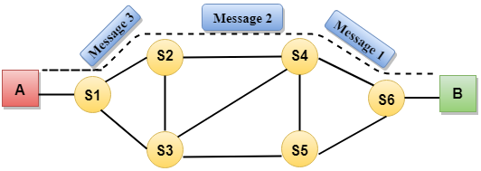
Communication through circuit switching has 3 phases:
Circuit establishment
Data transfer
Circuit Disconnect

Slide 4
Message Switching
Message Switching is a switching technique in which a message is transferred as a complete unit and routed through intermediate nodes at which it is stored and forwarded.
In Message Switching technique, there is no establishment of a dedicated path between the sender and receiver.
The destination address is appended to the message. Message Switching provides a dynamic routing as the message is routed through the intermediate nodes based on the information available in the message.
Message switches are programmed in such a way so that they can provide the most efficient routes.
Each and every node stores the entire message and then forward it to the next node. This type of network is known as store and forward network.
Message switching treats each message as an independent entity.

Slide 5
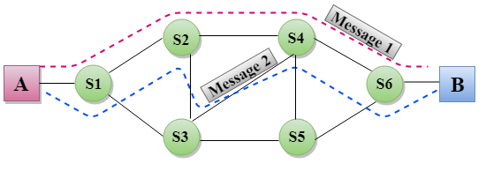
Advantages Of Message Switching
Data channels are shared among the communicating devices that improve the efficiency of using available bandwidth.
Traffic congestion can be reduced because the message is temporarily stored in the nodes.
Message priority can be used to manage the network.
The size of the message which is sent over the network can be varied. Therefore, it supports the data of unlimited size.
Disadvantages Of Message Switching
The message switches must be equipped with sufficient storage to enable them to store the messages until the message is forwarded.
The Long delay can occur due to the storing and forwarding facility provided by the message switching technique.

Slide 6
Packet Switching
The packet switching is a switching technique in which the message is sent in one go, but it is divided into smaller pieces, and they are sent individually.
The message splits into smaller pieces known as packets and packets are given a unique number to identify their order at the receiving end.
Every packet contains some information in its headers such as source address, destination address and sequence number.
Packets will travel across the network, taking the shortest path as possible.
All the packets are reassembled at the receiving end in correct order.
If any packet is missing or corrupted, then the message will be sent to resend the message.
If the correct order of the packets is reached, then the acknowledgment message will be sent.

Slide 7
Approaches Of Packet Switching:
There are two approaches to Packet Switching:
Datagram Packet switching:
It is a packet switching technology in which packet is known as a datagram, is considered as an independent entity. Each packet contains the information about the destination and switch uses this information to forward the packet to the correct destination.
The packets are reassembled at the receiving end in correct order.
In Datagram Packet Switching technique, the path is not fixed.
Intermediate nodes take the routing decisions to forward the packets.
Datagram Packet Switching is also known as connectionless switching.
Virtual Circuit Switching
Virtual Circuit Switching is also known as connection-oriented switching.
In the case of Virtual circuit switching, a preplanned route is established before the messages are sent.
Call request and call accept packets are used to establish the connection between sender and receiver.
In this case, the path is fixed for the duration of a logical connection.

Slide 8
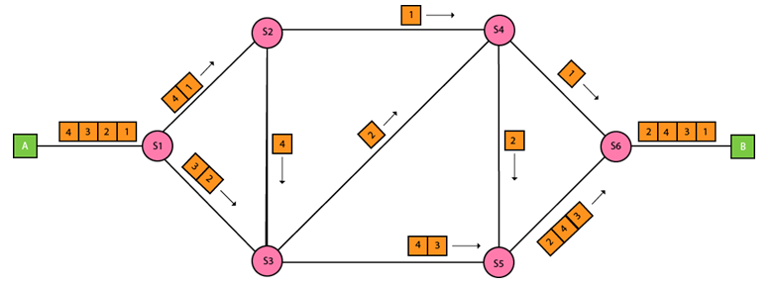

Slide 9
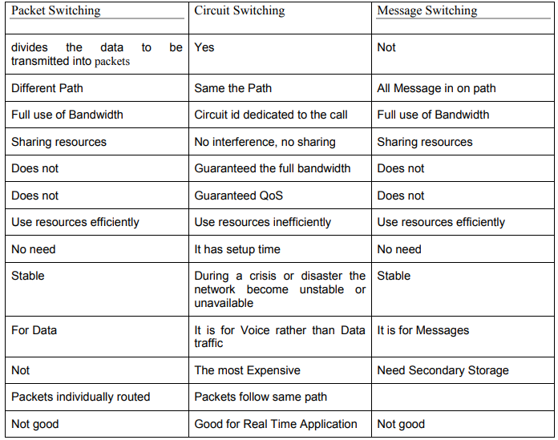

Slide 10
Circuit Switching It creates a direct physical connection between two devices.Circuit Switching reserves bandwidth in advance.Unused bandwidth is wasted in Circuit Switching.Each Packet follows the same Path. Example: Telephone System
Message Switching Here no physical connection is established.The message to be sent is stored in the first switch and checks for errors and the retransmitted (store and forward).This requires enough disk space to store the message in each switch and is very costly.The solution is dividing the message into different packets.
Packet Switching The message is divided into smaller packets and also no need to establish physical path in advance. It acquires bandwidth when needed and release soon after use. So no wastage of bandwidth.

